Slide 1
Analysis overview
Aligned sequences files [bam]
0_1 PCR duplicate removal (samtools)
1_1 Peak calling (MACS2)
Pileup files [treat_pileup.bed]
1_2 Sort
Peak files [.narrowPeak]
1_2 Normalization
1_2 Convert to bw
2_0 Samples Peak mergeing (Homer)
bdgaccuNORM.bw
[jycATAC_merged_peaks.bed]
UCSC genome browser
2_1 Convert to gff
[jycATAC_merged_peaks.gff]
4_0.0 motif annotation (Homer)
3_0 Tn5 insertion site count
Individual peak motif
[mtfANNO]
Sample Tn5 insertion site count
in each Peak [.count]
3_1 Normalization
Differential region TF controlled genes plot
Sample Tn5 insertion site count
TPM [.tpm]
4_0 Differential analysis (DEseq2)
Jinyong’s
gene groups
Differential output [G1_vs_G2.csv]
4_0 Selected differential peak regions
Differential regions
[G1_vs_G2-pval-0.05_up/dn.bed]
TF enrichment for
Each group of genes
4_0.1 Motif enrichment (Homer)
Differential region motif enrichment
[pval-0.05_updn…] Folder
Pathway analysis
Genomic features
Heatmaps

Slide 2
Naïve vs. each group Opened
Cutoff: > 10% any group
Cutoff: > 25% any group

Slide 3
Naïve vs. each group Closed
Cutoff: > 10% any group
Cutoff: > 25% any group

Slide 4
2. Differential motif frequency between KO-WT
Opened in the first group in comparison
e.g. Tfh v.s. Th1 – more open in Tfh
Cutoff: > 10% any group
Cutoff: > 25% any group

Slide 5
2. Differential motif frequency between KO-WT
Opened in the second group in comparison
e.g. Tfh v.s. Th1 – more open in Th1
Cutoff: > 10% any group
Cutoff: > 25% any group

Slide 6
3. Difference of motif enrichment % -- Comparing with WT Tfh – Naïve upregulated regions
Cutoff: >10% any group
Cutoff: >25% any group

Slide 7
3. Difference of motif enrichment %
-- Comparing with WT Tfh – Naïve – Downregulated regions
Cutoff: >10% any group
Cutoff: >25% any group

Slide 8
3. Difference of motif enrichment %
-- Comparing with WT Th1 – Naïve – Upregulated regions
Cutoff: >10% any group
Cutoff: >25% any group

Slide 9
3. Difference of motif enrichment %
-- Comparing with WT Th1 – Naïve –Downpregulated regions
Cutoff: >10% any group
Cutoff: >25% any group

Slide 10
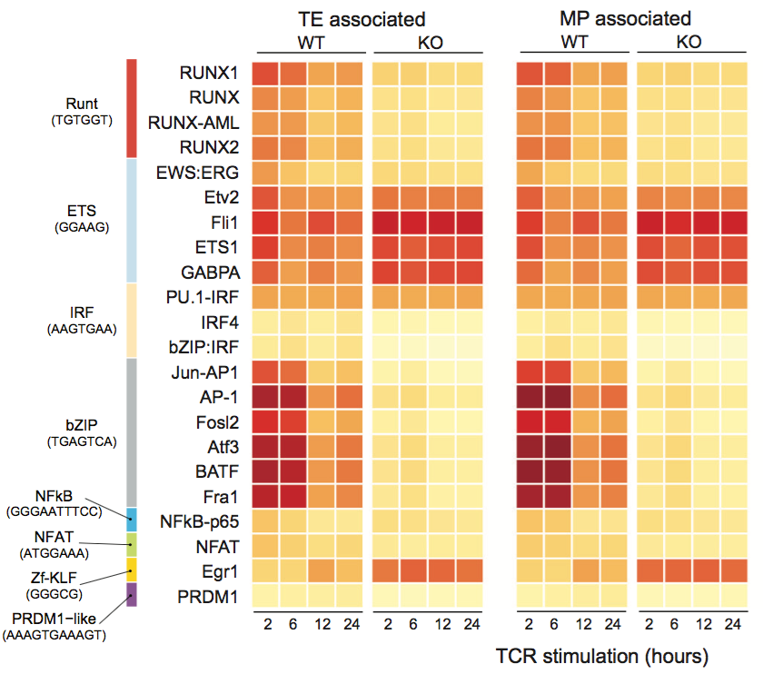

In progress…
3. Motif Enrichment on Tfh and Th1 associated genes or Group IV or Group II genes?
TFs
Tfh⁺ genes
TFs
Th1⁺ genes
Two approaches to try:
Use Tfh and Th1 associated gene set
Use Group IV and II gene set
TFH Associated
TH1 Associated
TFH Associated
TH1 Associated
WT_TFH
WT_TH1
WT_TFH
WT_TH1
PRDM1KO _TFH
DKO_TFH
PRDM1KO _TFH
DKO_TFH
TFs w/ motif
enrichment
Dapeng et al. Immunity 2018
Fig.S4E
(E) Motif enrichment was calculated within the cis-acting regions that were accessible in specific CTL subsets (indicated at top). Heatmaps depict the percentages of the most highly enriched TF motifs within regions that become accessible upon TCR stimulation (frequency in target sequences >15%, on-target frequency/background-frequency ratio ≥1.5, and pval ≤0.05; see methods and Table S2).

